Slide 1
FERMI
PROBLEMS
Solving the impossible…
Topic: Fermi Problems
EQ: How do Fermi problems help us in a Maths classroom?

Slide 2
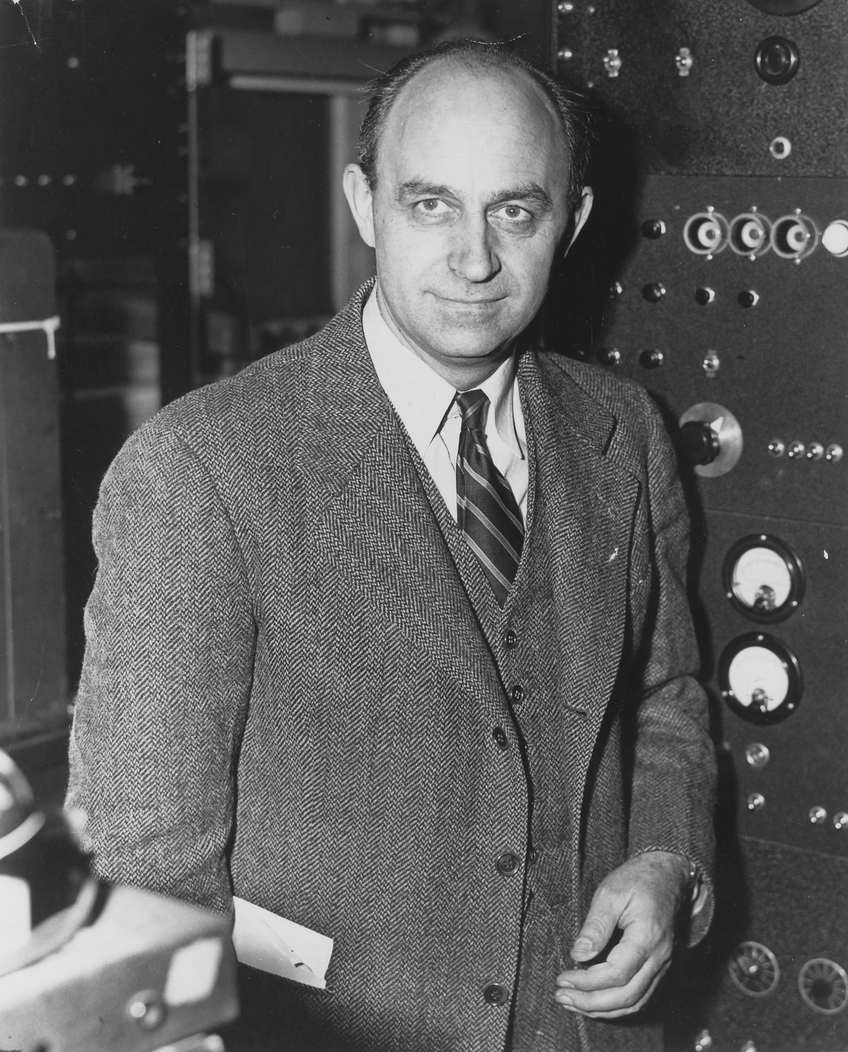
Meet Enrico Fermi (1901-1954)
Enrico Fermi was an Italian-American physicist and creator of the world's first nuclear reactor. In 1938 he received the Nobel Prize in physics for his discovery of nuclear reactions caused by slow neutrons.
Fermi was known for his ability to make good approximate calculations with little or no actual data.
Enrico Fermi Short Documentary

Slide 3
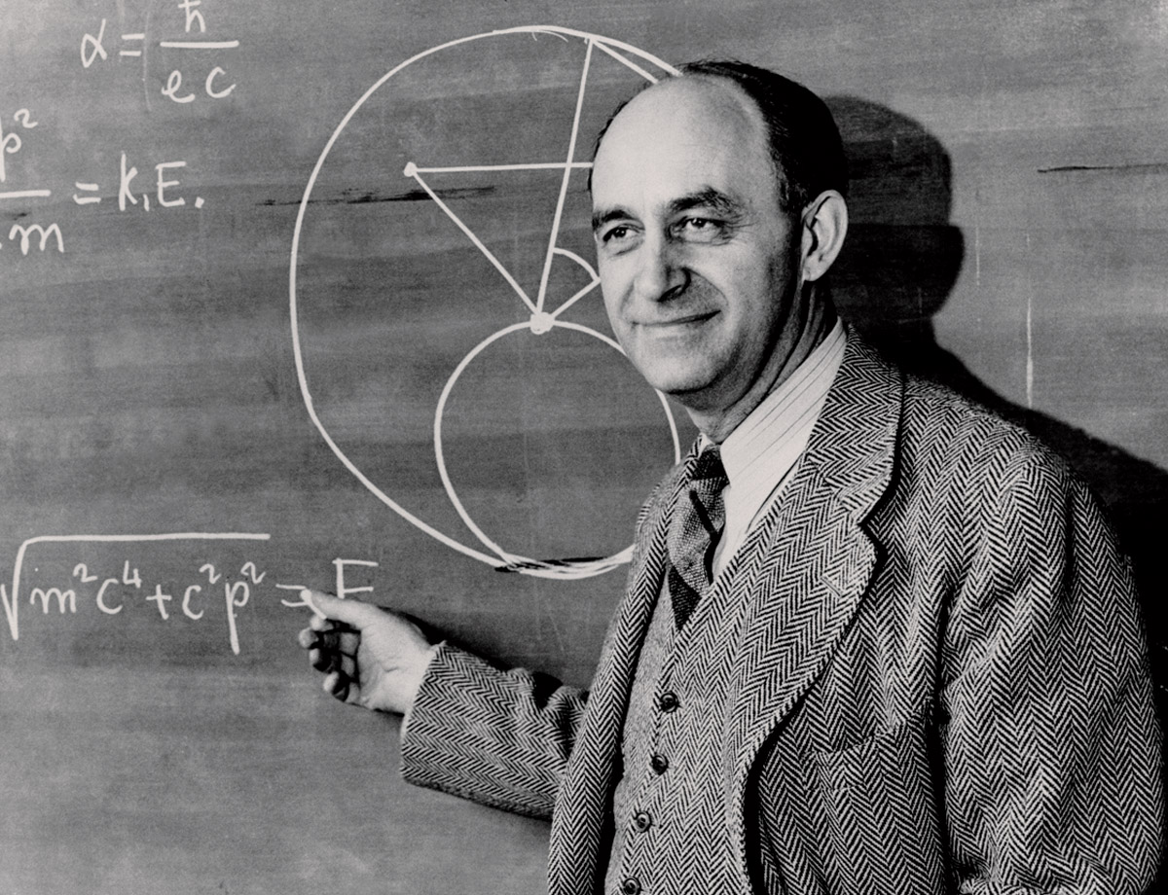
Fermi Questions
A “Fermi Question” is a question that asks for a quick estimate of a quantity that seems difficult or impossible to determine precisely.
For example, the question "How many drops of water are there in the Serpentine Dam?" requires an estimate of the volume of a drop, the volume of the Serpentine Dam from its approximate dimensions and conversion of units to yield an answer.
Fermi’s approach to such questions was to use common sense and rough estimates of quantities to piece together a ball-park value.

Slide 4

Fermi Problems
How far could you walk in one year?
How many piano tuners are there in Canada?
How many pounds of cheese were eaten in France last year?
How long would it take to count to 1,000,000?
© innovativeteachingideas.com

Slide 5
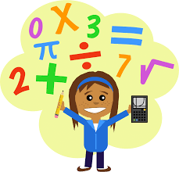
Skills Needed to Solve Fermi Questions
Many of the skills that you have learned in your math classes will help you solve Fermi Questions:
Modeling
Estimation
Measurement
Algebraic Expressions
Formulas
Problem Solving
Critical Thinking!
© innovativeteachingideas.com

Slide 6
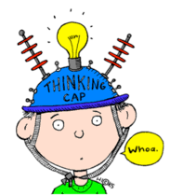
What is Critical Thinking?
Critical thinking is the ability to analyze information objectively and make a reasoned judgement. It involves the evaluation of sources, such as data, facts, observable phenomena and research findings. (source)
Fermi Problems are BIG questions that can seem impossible to answer. You must think critically and creatively to come up with estimates. The goal is not always to get an exact answer!

Slide 7
Goals for Fermi Questions
When solving Fermi Questions, our focus will be on process - not the final outcome. We hope to:
Generate many potential solutions to a given problem
Analyze problems for different points of view
Make decisions as a part of a group
Communicate mathematical ideas verbally and in writing
Create and utilize formulas to tackle a problem
Use internet search tools to find information
Hone estimation skills and confidence
Remember: The goal is not always to get an exact answer!

Slide 8
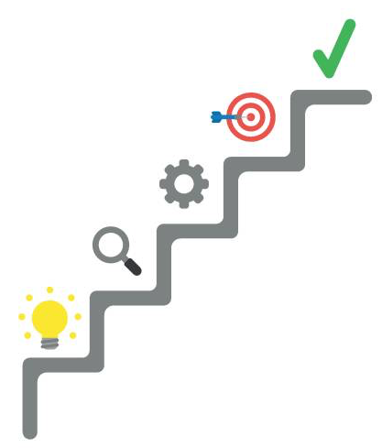
5 Steps for Answering Fermi Questions
Question
Wild Guess
Educated Guess
Gathering Data
Conclusion

Slide 9

Step 1: Question
State the question and clarify the interpretation.

Slide 10

Step 2: Wild Guess
Make a wild guess involving no calculations.

Slide 11
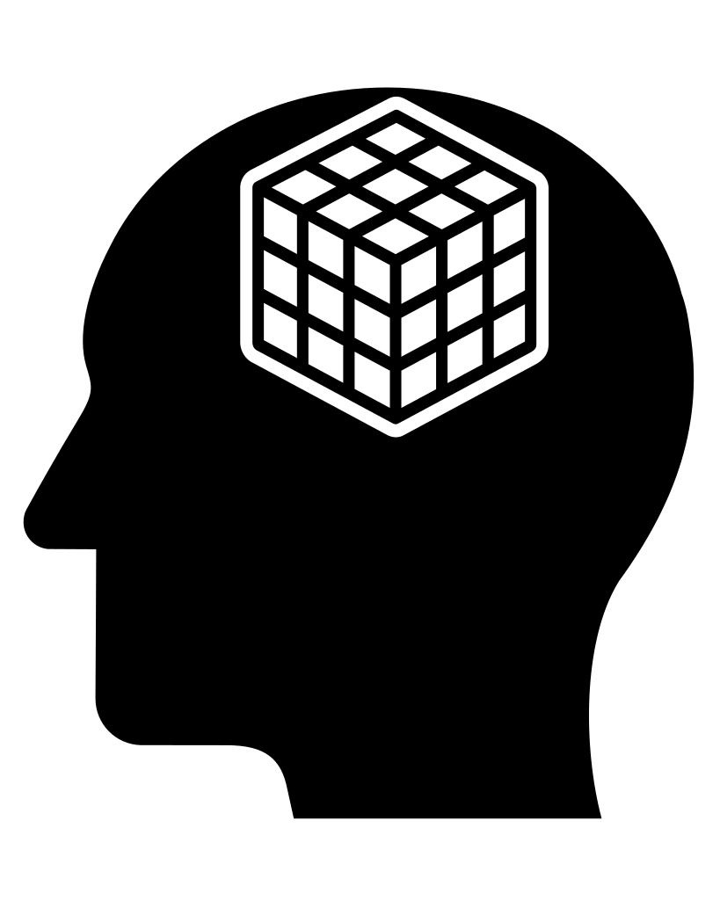
Step 3: Educated Guess
Make an educated guess involving a chain of reasoning and calculations based on everyday experiences and estimates.

Slide 12

Step 4: Gathering Data
Perform experiments, conduct surveys, make measurements or search for information that would help you obtain a more precise estimate.

Slide 13
Step 5: Conclusions
State your final answer to the question. Explain some possible sources of error in your procedure. List any interesting facts you learned while seeking the answer to the Fermi question.

Slide 14
How many times could you say the alphabet in 24 hours?
GUIDED EXAMPLE 1:

Slide 15
Step 1: Question
State the questions and clarify the interpretation.
We are being asked to find how many times a person could say the alphabet in 24 hours. We are interpreting this to mean; how many times could a person say the alphabet in 24 hours without stopping for any reason (for example to take a nap or go to the bathroom). We are only counting the time it takes for the person to recite the alphabet and not any other parts of the song (“now I know my ABC’s, next time won’t you sing with me”).

Slide 16
Step 2: Wild Guess
Make a wild guess involving no calculations.
Guess some numbers that are probably less than the real number and some that are probably more. Guess some that are close to the right answer.
How many times do you think you could recite the alphabet in 24 hours? 300 times? 3,000 times? 3,000,000 times?
Record your guesses on your worksheet.

Slide 17
Step 3: Educated Guess
Make an educated guess using a chain of logic to come up with an estimate. List some questions you would need to answer to figure out the Fermi Problem.
Some questions we may need to answer:
How many seconds are in 24 hours?
How long does it take to recite the alphabet?
Estimate using logic:
There are 26 letters in the alphabet. Assuming it takes me a second to say each letter, it would take me 26 seconds to say the alphabet.
At this rate I could roughly say the alphabet about 138 times in an hour. 138 x 24 = 3,312.

Slide 18
Step 4: Gathering Data
Perform experiments, conduct surveys and make measurements. If appropriate, create and use formulas.
There are 26 letters in the alphabet
It takes 13.6 seconds to recite the alphabet (you may want to perform your own experiment, or some research on Google)
There are 60 seconds in 1 minute, 60 minutes in 1 hour
There are 24 hours in one day
There are 3,600 seconds in 1 hour, 86, 400 seconds in 1 day
86,400
= 6,352.94
13.6

Slide 19
Step 4: Gathering Data, continued (optional)
Perform experiments, conduct surveys and make measurements. If appropriate, create and use formulas.
You may want to define variables and create a formula to help you solve this Fermi problem.
Let T represent the total time it takes (in seconds) to recite the alphabet and let x represent the numbers of repetitions. Th formula: T = 13.6x can help us calculate the time it will take (in seconds) to recite the alphabet a certain number of times.
86,400 = 13.6x
13.6
13.6
x=6,352.94

Slide 20
Step 6: Conclusion
State your final answer. Discuss possible sources of error, interesting facts learned and possible extensions.
Based on this analysis, we conclude that we can say the alphabet 6,352 times in 24 hours.
It takes 13.6 seconds to say the alphabet. Given that there are 86,400 seconds in 24 hour, one could recite the alphabet 6,352 times in that time frame.
One possible source of error is that we did not account for any breaks or mistakes. This might be unrealistic if attempted in real life.
One interesting fact I learned is that there are about 100 languages that use an alphabet similar to English. While some languages have a few more and others a few less, they all share the core 23 letters originally found in the Roman alphabet. It would be interesting to compare the number of times one could recite the alphabet in different languages given the same time frame.

Slide 21
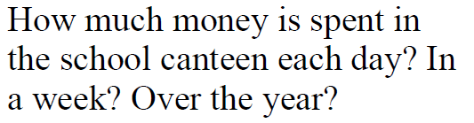
How many people do you think use the canteen each day?
How much money do you think they would spend each time?
How many days a week does the canteen run?
How many weeks in a school year?

Slide 22
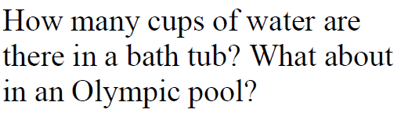
How big much volume is in a cup?
How many cups are needed to make a litre?
How many litres in an Olympic sized swimming pool?
How many cups are needed to fill an Olympic swimming pool?
Extension– how long would it take 1 person to drink?

Slide 23
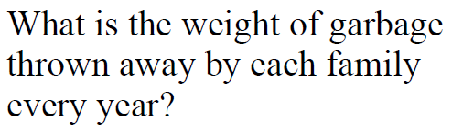

Slide 24
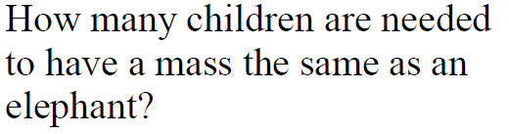

Slide 25
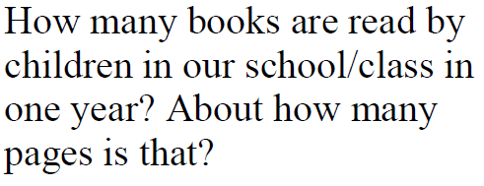

Slide 26
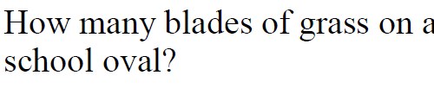

Slide 27


Slide 28
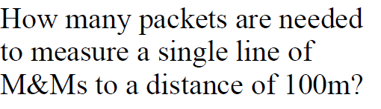

Slide 29
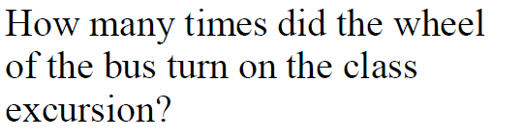

Slide 30


Slide 31
Some more Fermi Problems
What is the total number of marks taken in one AFL season?
How many hours will you spend on Facebook in a lifetime?
How many pizzas were eaten last year in Baldivis?
How many drops of water are there in the Indian Ocean?

